Slide 1
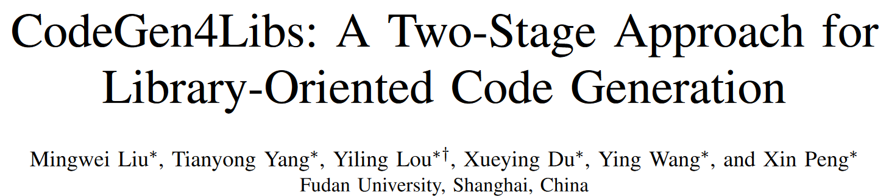
ASE 2023

Slide 2
Abstract
Problem library-oriented code generation.
Motivating survey of 66 participants about the problem.
Revisit existing codegen methods and find their ineffectiveness.
Propose a library-oriented codegen technique, CodeGen4Libs.
Including 2 stages: import generation and code generation.
Evaluated on a newly-constructed dataset (size: 403,780).
Outperforming baselines in both stages.
Improving up to 97.4% on EM, 54.5% on BLEU, and 53.5% on Hit@All.

Slide 3
Introduction
Developers expect codegen tools could be aware of more context.
But existing codegen techniques cannot do that.
These techniques only take standalone NL description as inputs, without considering other context.
We do not know how these techniques perform in such a more pragmatic codegen scenario.

Slide 4
Introduction
We perform an empirical study to
Motivate the problem of lib-oriented codegen via a survey from 66 participants.
Revisit the effectiveness of existing codegen techniques in lib-oriented codegen task.
Our findings:
Most developers want to use certain 3rd-party libs in their code.
But they often spend a moderate amount of time to find how to use their preferred libs.
We need a lib-oriented code generation.
Existing models exhibit poor performance on this.

Slide 5
Introduction
Developers: first identify the APIs they want to use and then write code based on that.
Our model (CodeGen4Libs): import gen and then codegen.
Import generation: generate import statements from NL with the given lib.
Code generation: generate concrete code based on NL and import.
Main intuition: imports can (1) bridge the gap between the lib and the code (2) and provide more context about the lib in codegen.

Slide 6
Contributions
A survey to motivate the lib-oriented codegen problem.
A revisiting study to demonstrate limited effectiveness of existing codegen techniques in lib-oriented codegen.
A novel approach CodeGen4Libs, including import gen and codegen.
An extensive evaluation to demonstrate its effectiveness.
A new dataset specifically constructed for lib-oriented codegen.

Slide 7
Motivational Study - Research Questions
RQ1
How much do developers prefer specific 3rd-party libs when coding?
RQ2
To what extent are developers familiar with the contextual intricacies of 3rd-party libs when coding?
RQ3
How effective are current models at generating code for specific 3rd-party libs without fine-tuning?

Slide 8
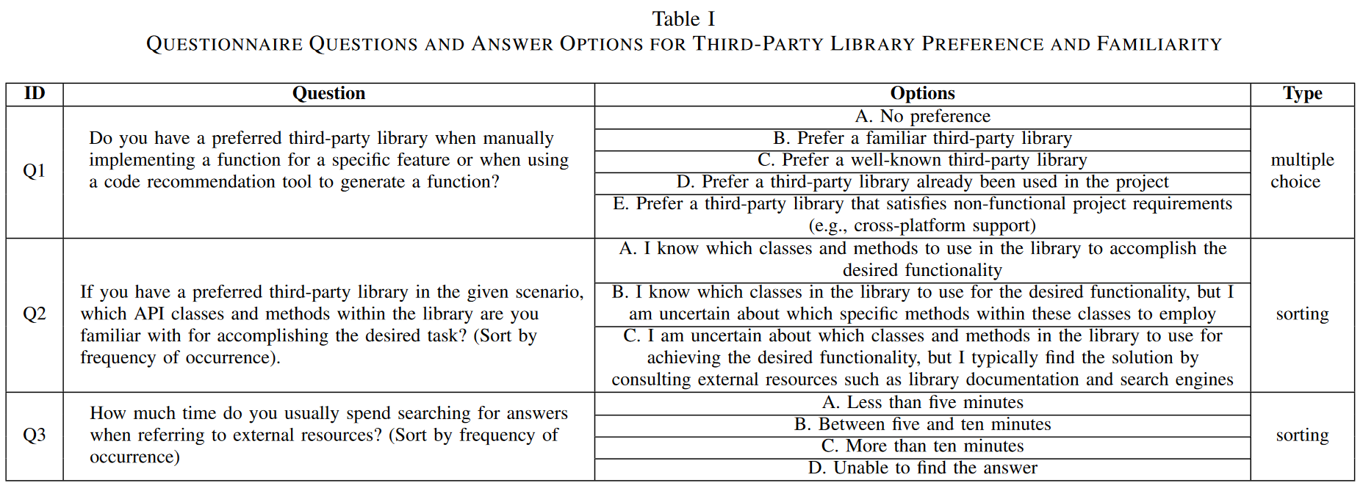
Motivating Study - Survey
Participants. 66 participants from diverse background.
undergraduate ~ doctoral level CS student.
devs of 1~5 year industrial experience.
9.1%
74.2%
59.1%
57.6%
21.2%
1.8
1.6
1.4
(1.6~2.5)
1.3
1.6
2.5

Slide 9
Motivating Study - Codegen Model Analysis
Dataset (small).
Extracted (NL, libs, import, code) from GitHub Code dataset (by CodeParrot).
Written in Java and using 3rd-party libs.
Code is method declaration and implementation (extracted using javalang).
NL is the corresponding method comment (necessary).
Imports are related class-level import statements.
Libs are obtained from the imports (including JDK and Android SDK).
Performed other common cleaning practices (size: 2,916,582).
Only obtain code that utilizes top-500 most-used libs (size: 1,215,900).
Randomly select 100 libs from 500 and choose 5 tuples / lib => 500 tuples.
Input: NL + " using the following libraries: " + libs.

Slide 10
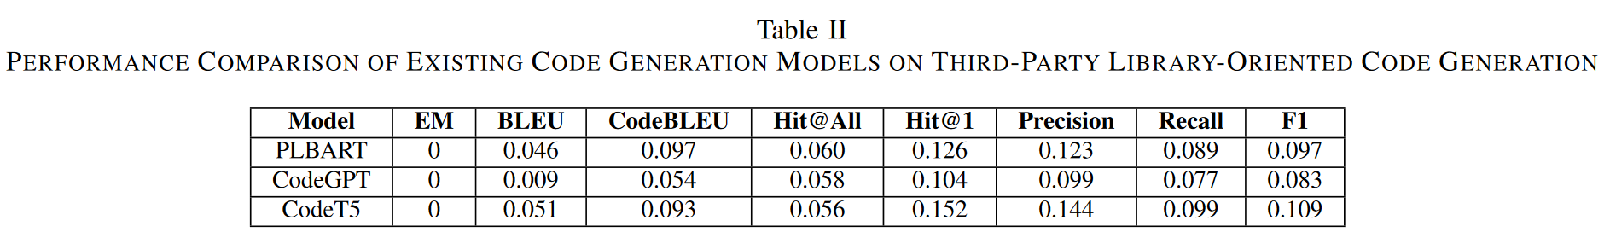
Motivating Study - Codegen Model Analysis
Hit@All. all 3rd-party correct classes are included.
Hit@1. at least one 3rd-party correct class is included.
Precision, Recall, F1 are calculated for the class prediction task.
Summary of the study: We need lib-orientated codegen techniques.

Slide 11
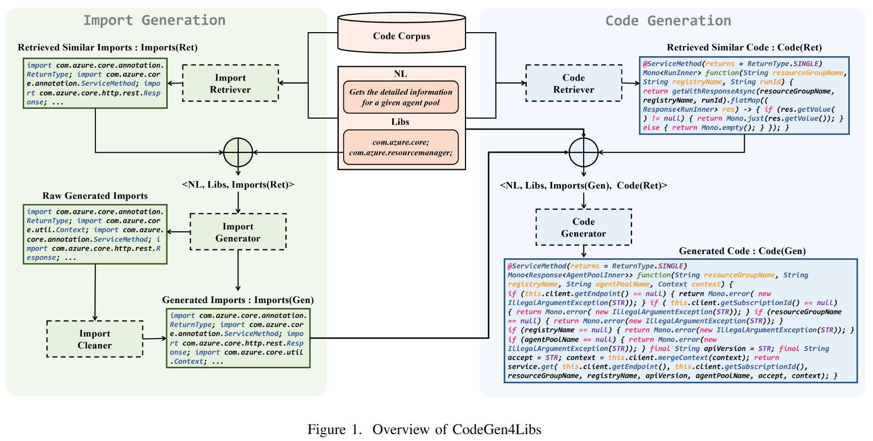
Approach
BM25 on NL
BM25 on NL
The first result that uses all given libs.
Remove other libs.
The first result that uses all given libs.
Fine-tuned CodeT5.
Fine-tuned CodeT5.
Remove duplicate or incomplete imports.

Slide 12
Evaluation
RQ1 (Effectiveness of Library-oriented Imports Generation)
How effective is CodeGen4Libs in generating high-quality library-oriented imports?
RQ2 (Effectiveness of Library-oriented Code Generation)
How effective is CodeGen4Libs in generating high-quality library-oriented code?
RQ3 (Imports Generation Quality Impact)
To what extent does the quality of import generation affect the quality of code generation results?

Slide 13
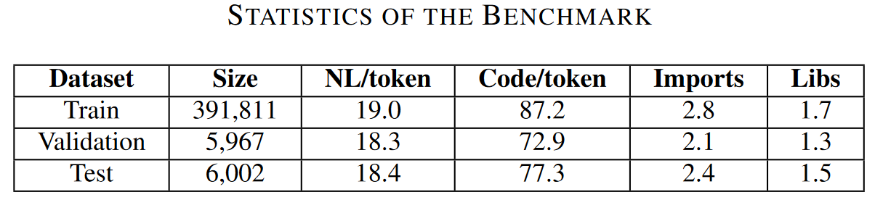
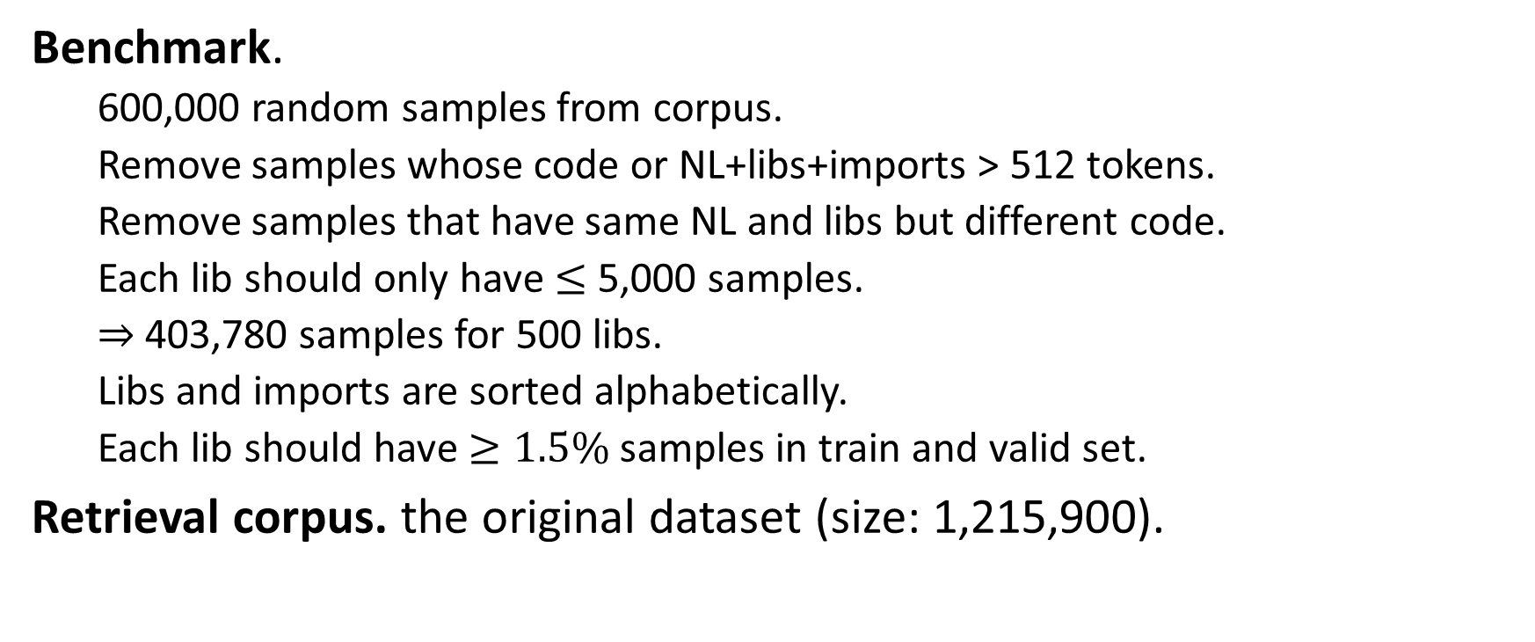
Experiment Setup - Benchmark
Benchmark.
600,000 random samples from corpus.
Remove samples whose code or NL+libs+imports > 512 tokens.
Remove samples that have same NL and libs but different code.
Each lib should only have $≤$ 5,000 samples.
$⇒$ 403,780 samples for 500 libs.
Libs and imports are sorted alphabetically.
Each lib should have $≥1.5\%$ samples in train and valid set.
Retrieval corpus. the original dataset (size: 1,215,900).

Slide 14
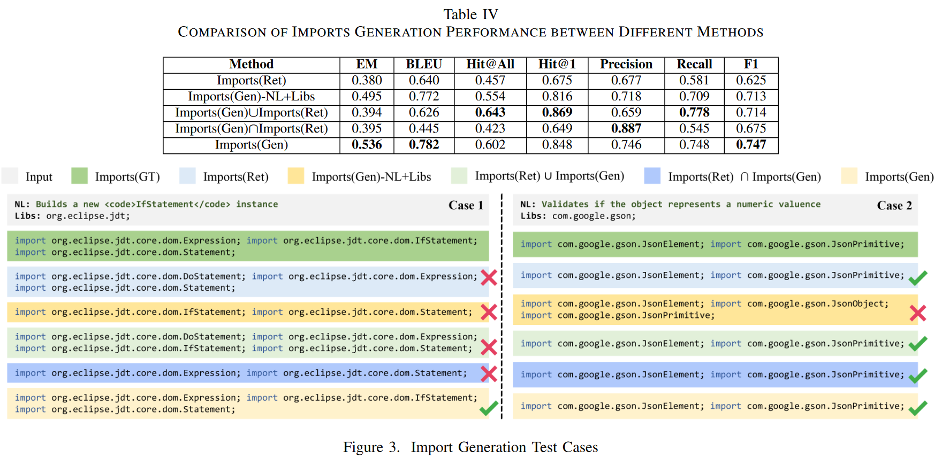
Evaluation - RQ1

Slide 15
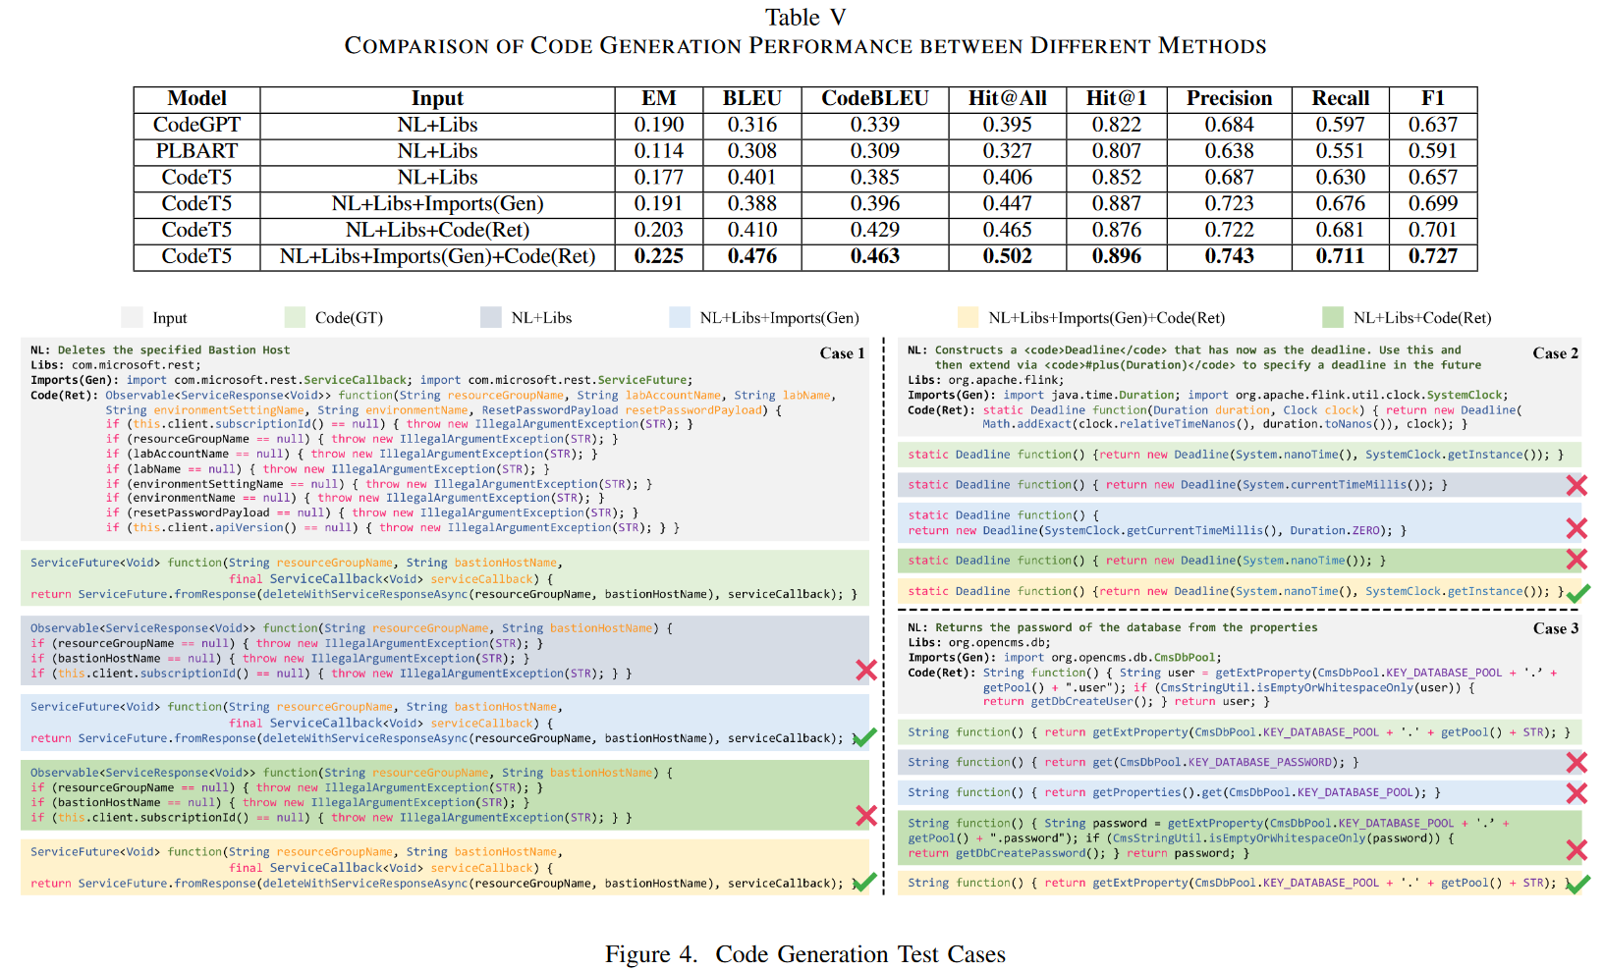
Evaluation - RQ2

Slide 16
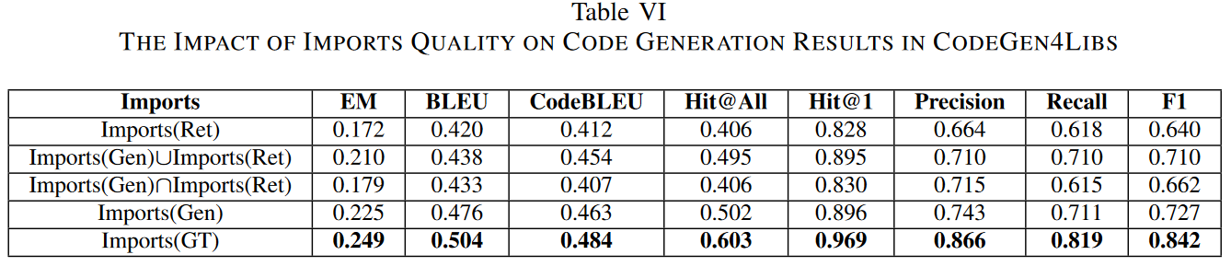
Evaluation - RQ3

Slide 17
Contributions
A survey to motivate the lib-oriented codegen problem.
A revisiting study to demonstrate limited effectiveness of existing codegen techniques in lib-oriented codegen.
A novel approach CodeGen4Libs, including import gen and codegen.
An extensive evaluation to demonstrate its effectiveness.
A new dataset specifically constructed for lib-oriented codegen.

